Slide 1
SAP BTP Extension Suite Training
Day 11
Anubhav Oberoy
www.AnubhavTrainings.com
Follow excellence with sheer passion

Slide 2


DISCLAIMER
The training content and delivery of this presentation is confidential, and cannot be recorded, or copied and distributed to any third party, without the written consent of Anubhav Trainings

Slide 3
Agenda – Day 11
01
Source Code Management
02
Working with HANA Cloud
03
HDI Containers

Slide 4

Challenges
I had created a CAP project, last evening it was stable, this morning when I come to office I made several changes and it destabilized code, I want to go back to last stable state?
Is there any versioning feature in source code for BAS or VS Code tool
We want to track our code change, so we can do a code compare
When someone leave the team, or on leave, we want to make sure that other team members have access to the latest code.
How we manage a project where the team is spread across multiple locations, how can we sync our code between developers
In my company one developer using BAS and another using VS code, how to move the code between machines and dev tools
My BAS is a private dev space, how do I share code with colleagues, shall I share a zip file?
Git and git hub
Git – source code version management tool can manage all kinds of source code.
GitHUB – (google drive for developer) – Central source code repository which store code on internet to allow collab. Between teams and take a global backup.

Slide 5
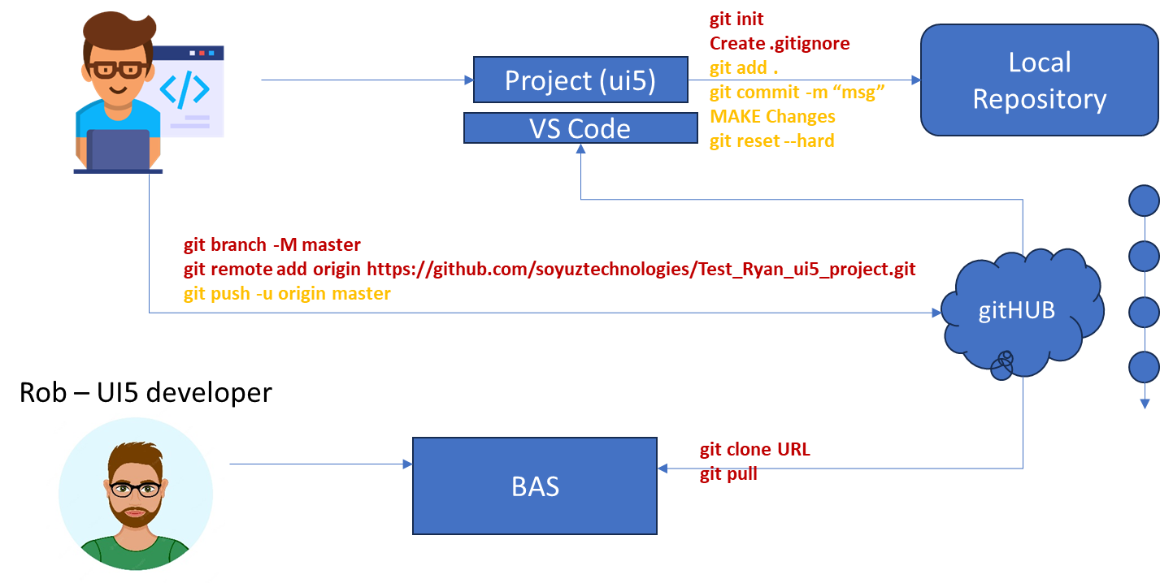










Git and Git HUB

Slide 6
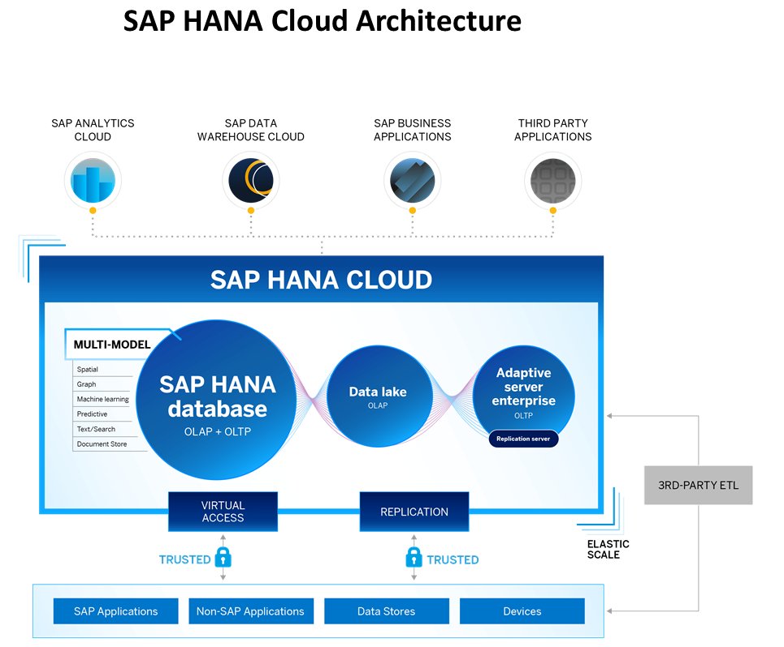
Introduction to HANA Cloud
SAP HANA Cloud is a fully managed, in-memory, cloud database as a service (DBaaS). It is the cloud-based data foundation for SAP Business Technology Platform. With SAP HANA Cloud you can create, run, and extend new and existing applications.
SAP HANA Cloud includes a number of software components. The core component is SAP HANA Database, but other components can be added at any time, such as a data lake.
Key Components of SAP HANA Cloud
There are four key components of SAP HANA Cloud:
SAP HANA Cloud, SAP HANA Database
  In-memory database with built-in advanced analytics (spatial, graph, text, etc.)
SAP HANA Cloud, data lake
  Store and query large data sets and most file types
SAP HANA Cloud, adaptive server enterprise
  Support for extreme –performance transactional applications
SAP HANA Cloud, adaptive server enterprise replication
  Bi-directional real time data replication across databases

Slide 7
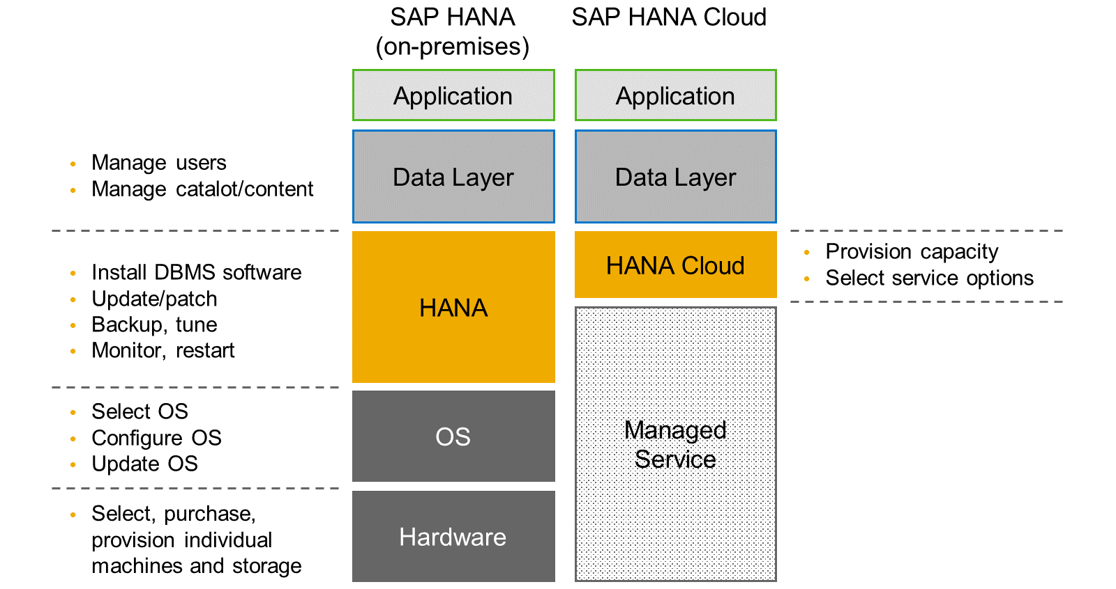
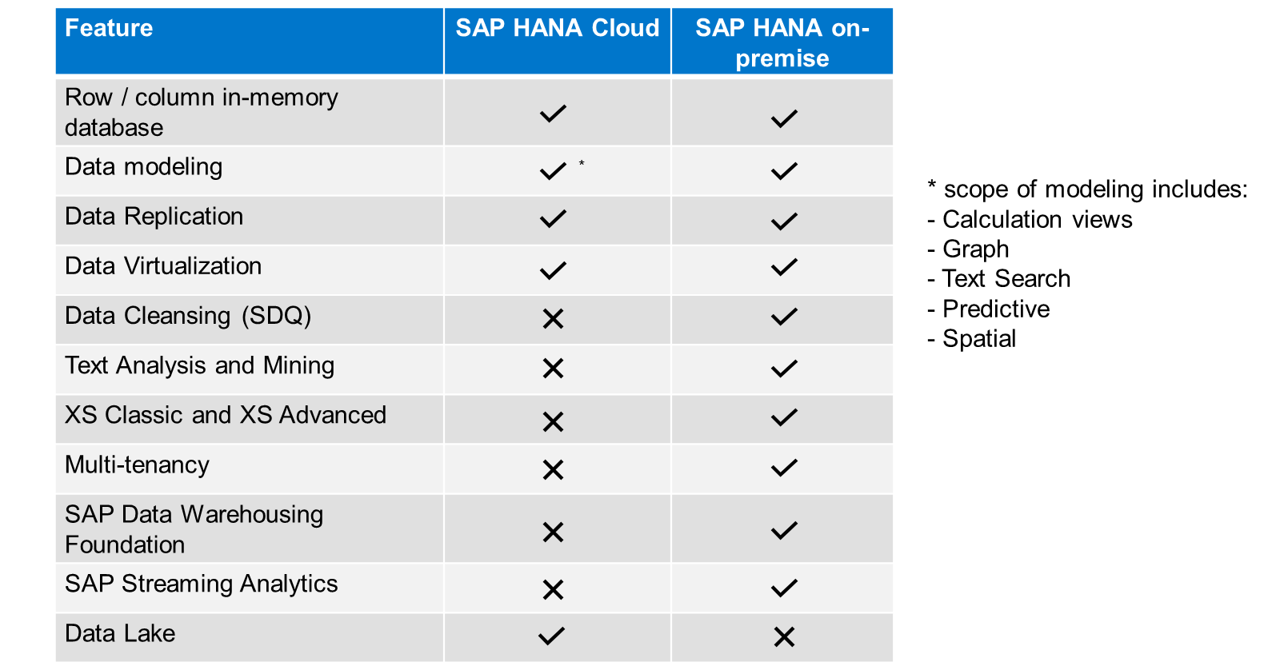
HANA Cloud v/s On-premise
Feature Differences
SAP HANA Cloud compares very closely with SAP HANA on-premise in terms of features but there are some differences.

Slide 8
What is Schema in HANA
Schema – Is a mandatory database object of database which stores other database objects.
It’s a logical separation of database objects.
It is home of all the runtime object
Security
BW
ekko
ECC
ekko
S/4HANA
ekko
Non-SAP
SAP HANA 600GB
SCBW
ekko
ECC001
ekko
SAPS4C
ekko
MIG
ekko
SYS

Slide 9
HDI Container
An HDI Container is also a schema. But it is managed differently from a normal schema.
Schema -- How its created?
Manually create it in BTP
Application Managed HDI Container (You as developer ONLY work with App, App will talk to HANA to create and manage this schema to store/read data internally)
You cant access HDI Container using HANA Studio (Deprecated tool), We can use new SAP HANA Database Explorer, SAP HANA WebIDE for OP or BAS to access HDI Container.
HDI -- Who creates it?
There is a new service in SAP HANA called SAP HDI (HANA Deployer Infrastructure) which is just a microservice responsible to managing the container. HDI Deployer is a component which is used to talk to this service from our app.

Slide 10
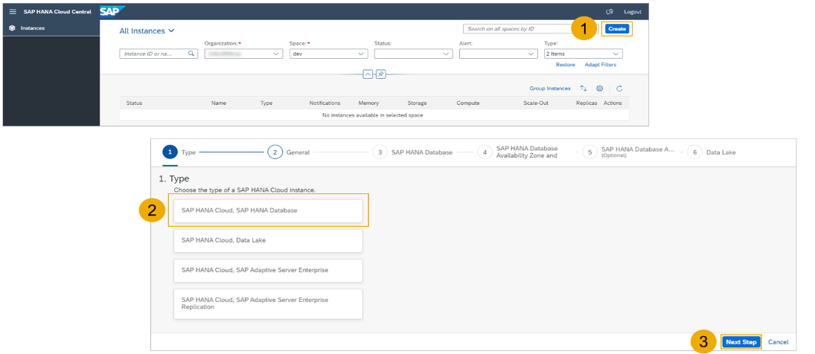
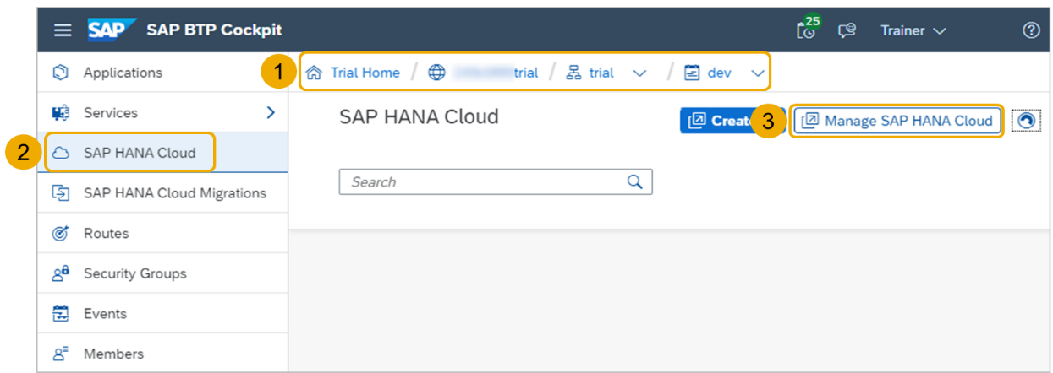
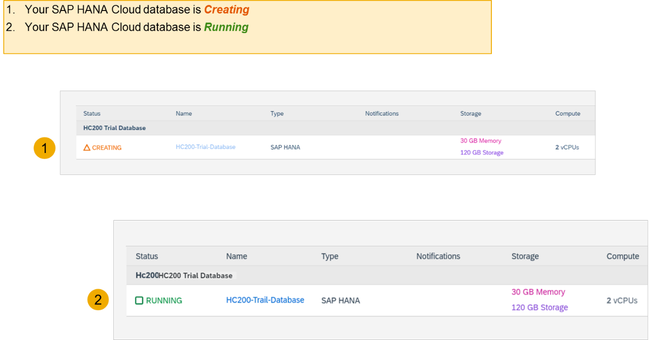
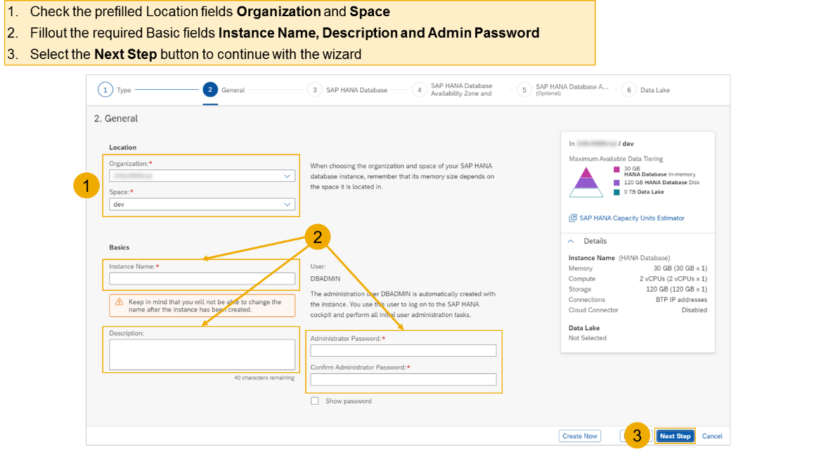
Hands on - Create HANA Cloud Instance
Login to your trial and navigate to your dev space
Select SAP HANA Cloud
Select the Manage SAP HANA Cloud button to start the SAP HANA Cloud Central
Select the Create button to start the wizard
Select the SAP HANA Cloud instance Type to create
Select the Next Step button to continue

Slide 11
HDI Container
An HDI Container is also a schema. But it is managed differently from a normal schema.
Schema -- How its created?
Manually create it in BTP
Application Managed HDI Container (You as developer ONLY work with App, App will talk to HANA to create and manage this schema to store/read data internally)
You cant access HDI Container using HANA Studio (Deprecated tool), We can use new SAP HANA Database Explorer, SAP HANA WebIDE for OP or BAS to access HDI Container.
HDI -- Who creates it?
There is a new service in SAP HANA called SAP HDI (HANA Deployer Infrastructure) which is just a microservice responsible to managing the container. HDI Deployer is a component which is used to talk to this service from our app.

Slide 12
Hands on - Create HANA Cloud Instance
Login to your trial and navigate to your dev space
Select SAP HANA Cloud
Select the Manage SAP HANA Cloud button to start the SAP HANA Cloud Central
Select the Create button to start the wizard
Select the SAP HANA Cloud instance Type to create
Select the Next Step button to continue

Slide 13


Design time

Slide 14
Hands on – HANA Cloud Integration
Pre-requisites
Check the version of CDS (which must be > 2.0) cds –v
Start a HANA cloud instance in SAP BTP
Main steps
Add hana configuration to our app, which tell cap framework that the default db is now hana – cds add hana
2. Add the hana specific deployment format name to our project under cds section as below inside package.json file
"hana":{
"deploy-format":"hdbtable"
}
3. Since the first step added the hdb node module, we need to install it. Run npm install
4. We need to perform a build, which will create all the hana specific files which will be deployed to HANA cloud. cds build --production
5. We need to login to cloud foundry from BAS – cf login
6. Finally we need to deploy the DB and everything to SAP HANA Cloud – cds deploy --to hana:batman
7. We fixed issues related to excel format of HANA and changed the size of field bankid for employee, redo the build and deploy
8. If deployment worked, a new file cdsrc-private.json gets created automatically, this file contain the information about which container in SAP BTP HANA Cloud to connect to. And the private key is stored in this file.
9. Provide the credentials which will be used to connect database, start using cds watch --profile hybrid
"credentials": {
"database": "batman-key"
}

Slide 15
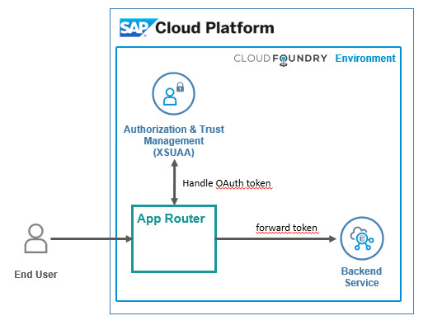
Hands on: App Router
Solution
https://github.com/soyuztechnologies/BTP_Architect_Training/blob/master/Day%203/04approuter.zip

Slide 16

What We Did
Let’s Summarize

Slide 17

www.anubhavtrainings.com
Thank You
End of Day 6

Slide 18


We’re committed to empower you to be
#FutureReady
through powerful training solutions.
We build the workforce of the future.
260+
Corporate Clients
60,000+
Learners Trained
26000+
Learners Placed
FREE WEBINARS
Sign up for free webinars with industry experts every fortnight!
Enroll Now!
Contact us today!
https://anubhavtrainings.com

